Slide 1
Writing Word Equations

Slide 2
By the end of this lesson, you should be able to:
• | Understand what chemical equations are used for.
• | Identify reactants, products and required reaction conditions in a chemical reaction.
• | Construct a word equation.

Slide 3
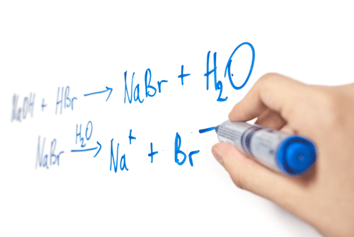
Chemical equations are a way of writing down what happens in a chemical reaction.
Like a cooking recipe, they show which reactants produce which products, and include the required reaction conditions for that reaction.
It is useful having chemical equations because they allow you to replicate reactions discovered by other people. This is just like a cooking recipe allowing you to make a cake which was invented by someone else.
Chemical equations can help us understand how the bonds in the reactants have been changed or rearranged to form products.

Slide 4

Chemists use a certain set of conventions (or rules) to write chemical equations.
Reactants are always on the left and products on the right.
An arrow is drawn from the reactants to the products.
Plus signs are used to connect multiple reactants or products.

Slide 5

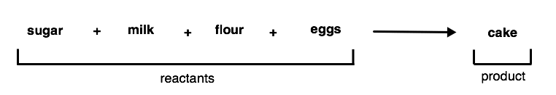
Let us practise writing word equations using a cooking example.
When we bake a cake, we mix up the ingredients and put them into the oven to add heat. The ingredients react to produce a cake.
The ingredients are the reactants, the cake is the product and the time and temperature in the oven are the reaction conditions.
With the ingredients being the reactants and the cake the product, the equation would look something like this:

Slide 6
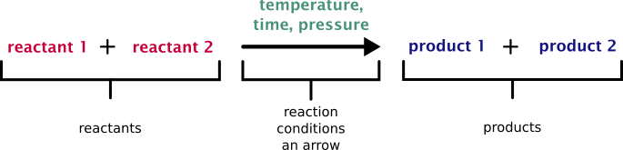
Reaction conditions are also shown in chemical equations.
When reaction conditions are included, they are written above the arrow.
Putting all these rules together, we can now write a full word equation:

Slide 7
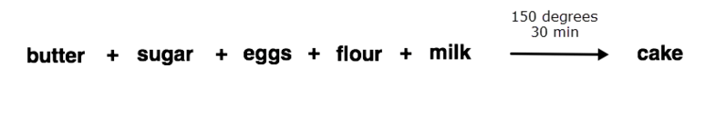
Let us add the reaction conditions to our chemical equation about baking cakes.
When you bake a cake, you leave it in a hot oven for several minutes.
The time and temperature in the oven are the reaction conditions.
Here is our new, complete equation:

Slide 8
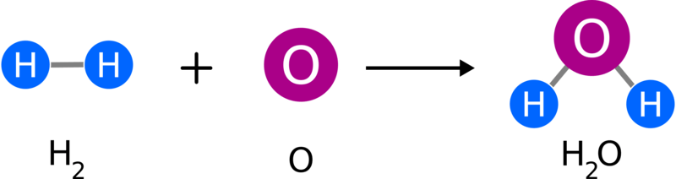
In summary, chemical equations are used to record what happens during a chemical reaction.
When writing a chemical equation you:
- | Place reactants on the left and products on the right;
- | Draw an arrow from the reactants to the products;
- | Connect multiple reactants or products with plus symbols;
- | Write reaction conditions above the arrow.

Slide 9
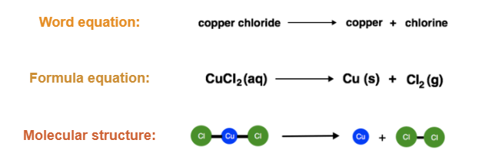
We have learned that chemical equations are the way we write down chemical reactions. But did you know there are three types of chemical equations?

Slide 10



The equation types all follow the same conventions (the use of arrows and plus symbols as well as placement of reactants, products and reaction conditions).
They only differ in the name or symbols used to represent the reactants and products.
Word equations use the written name.
Formula equations use the chemical formula.
Molecular equations use pictures of the molecular structure.

Slide 11
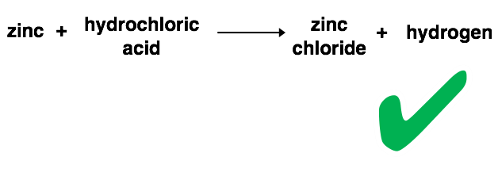
The simplest equation is a word equation.
To make a word equation, you write down the names of the reactants and products.
Remember, reactants go on the left and products on the right.

Slide 12
You have already seen word equations, but try making one from scratch using this recipe. The answer is on the next slide.
"Mix together the butter and sugar using an electric whisk until it is pale. Slowly beat in the eggs. Sift the flour into the bowl and gently fold in. Add some milk until the batter is at dropping consistency. Bake in the oven for 30 minutes at 150 degrees and leave the finished cake to cool before decorating."

Slide 13

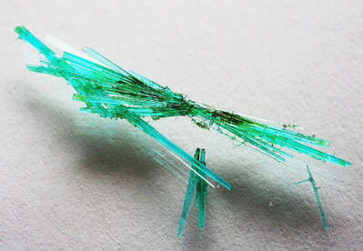
We can also write word equations for a chemical reaction a scientist might do in a lab by using the written instructions for that reaction.
"When we apply energy to a solution of copper chloride, the copper chloride will break down to give solid copper metal and release chlorine gas."
The word equation looks like this:

Slide 14
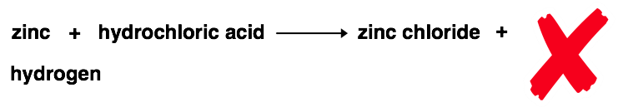
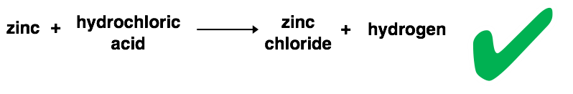
When we are writing a word equation, or any other type of chemical equation, it must only be written on one line:
For example: "If we add hydrochloric acid to zinc metal it will bubble and fizz as it releases hydrogen gas and the solution becomes zinc chloride."
Instead of writing the remaining products on the next line we do this:

Slide 15
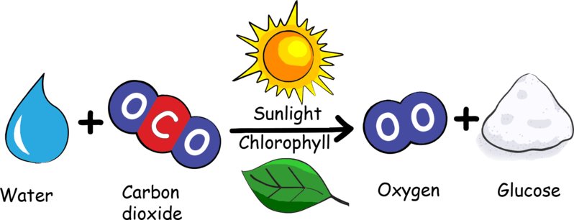
In summary:
There are three types of chemical equations.
The simplest is word equations, which use the written names of the reactants and products.

